Slide 1
Data Ethics and Privacy
IS465: Data Management and Governance

Slide 2
Outline
Introduction to Data Ethics
Ethical Considerations in Data Management
Data Privacy Regulations and Compliance
Data Ethics and Data-Driven Decision-Making
Case Studies and Examples

Slide 3
Introduction to Data Ethics

Slide 4
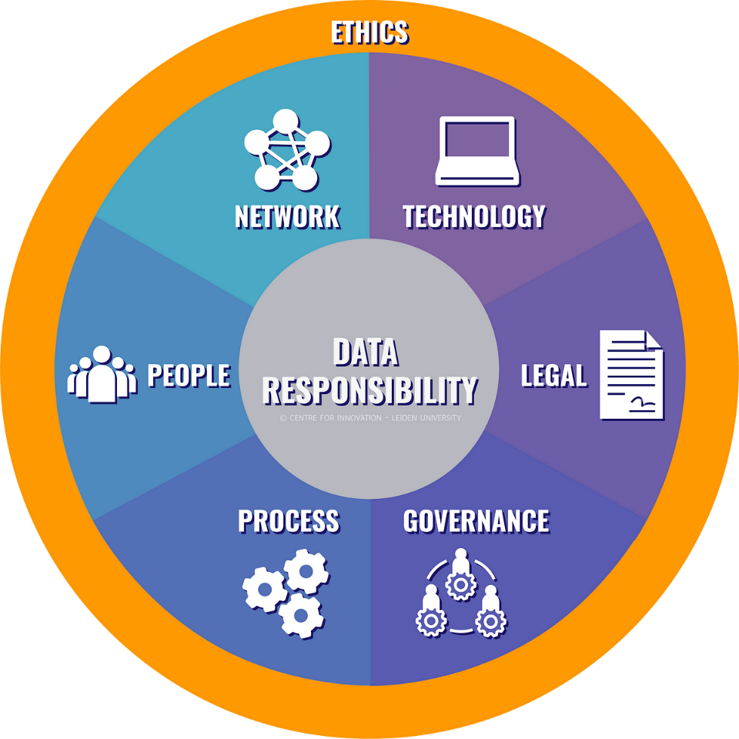
Unlocking Insights from Data
Responsible Data Management in the Digital Age

Slide 5
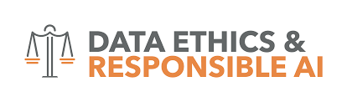
What is Data Ethics?
Data ethics refers to the moral principles and values that guide the design, development, and use of data-driven systems, ensuring that they are fair, transparent, and respectful of individuals and society.
Concerned with the social and moral implications of data collection, storage, and use
Involves considering the potential consequences of data-driven decisions on individuals and society
Aims to promote fairness, accountability, and transparency in data management

Slide 6

Why Data Ethics Matters
Ensures fairness and non-discrimination in AI-driven decision-making
Protects individual privacy and autonomy
Builds trust and accountability in data-driven systems
Encourages transparency and explainability in data analysis and decision-making
Helps mitigate the risks of data breaches and misuse

Slide 7
The Evolution of Data Ethics
From data protection to data ethics: a shift from focusing on security to considering the broader social implications of data use
From individual privacy to collective well-being: recognizing the impact of data-driven systems on society as a whole
From compliance to accountability: moving beyond mere regulatory compliance to taking responsibility for the consequences of data-driven decisions
From ethics as an afterthought to ethics by design: integrating ethical considerations into the design and development of data-driven systems

Slide 8
Key Principles of Data Ethics
Transparency: ensuring that data collection, storage, and use are open and understandable
Accountability: taking responsibility for the consequences of data-driven decisions
Fairness: ensuring that data-driven systems do not discriminate or perpetuate biases
Privacy: protecting individual autonomy and confidentiality
Explainability: ensuring that data analysis and decision-making are transparent and understandable

Slide 9
Real-World Examples of Data Ethics in Action
Cambridge Analytica and Facebook: a cautionary tale about data misuse and lack of transparency
AI-powered hiring tools: highlighting the risks of bias and discrimination in AI-driven decision-making
GDPR and data protection regulations: demonstrating the importance of accountability and transparency in data management

Slide 10
Real-World Examples of Data Ethics in Action
Saudi Data and Artificial Intelligence Authority (SDAIA)
data anonymization policy to protect citizens' personal data, ensuring that data is de-identified and aggregated before being shared or used for analytics.
Saudi Ministry of Health
centralized data repository for electronic health records, which is protected by robust security measures and access controls to ensure confidentiality and integrity.

Slide 11
Ensuring Fairness, Transparency, and Accountability
Bias refers to the systematic error or distortion in data collection, analysis, or interpretation that can lead to unfair or discriminatory outcomes.
Biased data can perpetuate existing social inequalities
Biased algorithms can make unfair decisions
Biased analysis can lead to misleading conclusions

Slide 12
Examples of Biased Data and its Consequences
Racial bias in facial recognition technology
Gender bias in job candidate screening algorithms
Socioeconomic bias in credit scoring models
Biased data can lead to discriminatory outcomes
Biased data can perpetuate existing social inequalities
Biased data can undermine trust in data-driven systems

Slide 13
Strategies for Mitigating Bias in Data Collection
Diverse and representative data collection
Data anonymization and aggregation
Regular auditing and testing for bias
Human oversight and review

Slide 14
Strategies for Mitigating Bias in Data Analysis
Using multiple data sources and models
Regularly updating and refining models
Human oversight and review
Transparency and explainability in model development

Slide 15
Transparency in Data Management
Transparency refers to the openness and clarity of data collection, analysis, and use, ensuring that stakeholders understand how data is being used and for what purposes.
Ensures accountability and trust
Enables informed decision-making
Facilitates collaboration and knowledge-sharing

Slide 16
Importance of Transparency in Data Collection
Ensures informed consent
Enables data subjects to correct errors
Facilitates accountability and trust

Slide 17
Importance of Transparency in Data Analysis
Enables reproducibility and verification
Facilitates collaboration and knowledge-sharing
Ensures accountability and trust

Slide 18
Role of Accountability in Ensuring Ethical Data Management
Accountability refers to the responsibility and answerability of individuals and organizations for their actions and decisions in data management.
Ensures compliance with regulations and laws
Encourages ethical behavior and decision-making
Facilitates trust and confidence in data-driven systems

Slide 19
Privacy and Confidentiality in Data Management
Privacy refers to the protection of personal data and confidentiality refers to the protection of sensitive information.
Ensures individual autonomy and dignity
Protects sensitive information from unauthorized access
Facilitates trust and confidence in data-driven systems

Slide 20
Importance of Protecting Sensitive Information
Prevents identity theft and fraud
Protects individuals from harm or discrimination
Ensures compliance with regulations and laws

Slide 21

Strategies for Ensuring Privacy and Confidentiality
Data encryption and secure storage
Access controls and authentication
Anonymization and pseudonymization
Regular security audits and testing

Slide 22
Ethical Considerations in Data Management

Slide 23
Protecting Personal Data in the Digital Age
Overview of Major Data Privacy Regulations
General Data Protection Regulation (GDPR)
Health Insurance Portability and Accountability Act (HIPAA)
Payment Card Industry Data Security Standard (PCI DSS)
Other regional and industry-specific regulations

Slide 24
Saudi Arabia
Personal Data Protection Law (PDPL)
Saudi Arabian Monetary Authority (SAMA) Regulations
Communications and Information Technology Commission (CITC) Regulations
General Authority for Civil Aviation (GACA) Regulations
Saudi Arabian General Investment Authority (SAGIA) Regulations
National Cybersecurity Authority (NCA) Regulations
Health Data Regulations

Slide 25
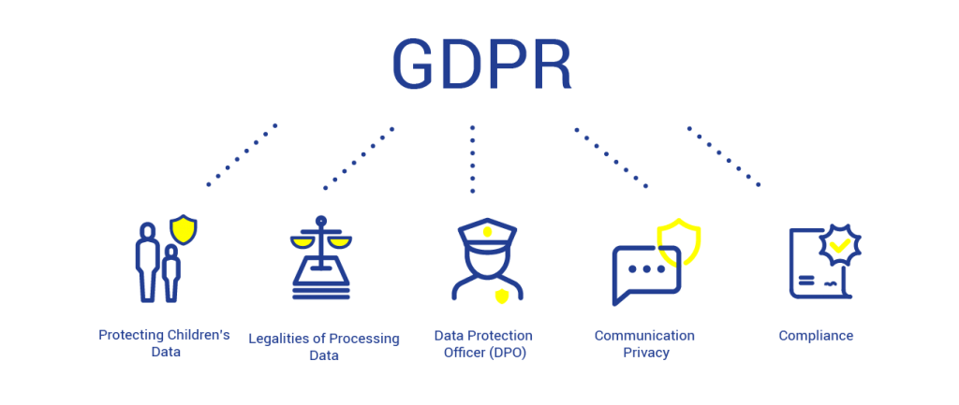
General Data Protection Regulation (GDPR)
The GDPR is a European Union regulation that aims to protect the personal data of EU citizens and residents.
Key points:
Applies to organizations processing EU personal data
Introduces data subject rights, such as access and erasure
Mandates data protection by design and default
Imposes breach notification and response requirements

Slide 26
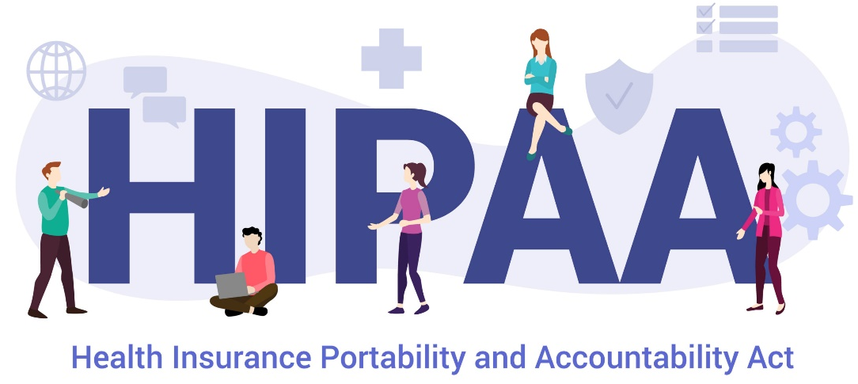
Health Insurance Portability and Accountability Act (HIPAA)
HIPAA is a US federal law that aims to protect the privacy and security of protected health information (PHI).
Key points:
Applies to healthcare providers, insurers, and clearinghouses
Mandates the protection of PHI, including electronic PHI
Introduces data subject rights, such as access and amendment
Imposes breach notification and response requirements

Slide 27
Key Components of Data Privacy Regulations
Data subject rights, such as access, erasure, and portability
Data protection by design and default
Breach notification and response requirements
Transparency and disclosure of data collection practices
Accountability and compliance obligations

Slide 28

Data Subject Rights
Right to access personal data
Right to rectify or correct personal data
Right to erase or delete personal data
Right to restrict processing of personal data
Right to data portability

Slide 29
Data Protection by Design and Default
Data protection by design and default refers to the integration of data protection principles into the design and development of products, services, and systems.
Key points:
Mandates data protection considerations throughout the data lifecycle
Encourages privacy-enhancing technologies and practices
Reduces the risk of data breaches and unauthorized access

Slide 30

Breach Notification and Response
Breach notification and response refers to the process of notifying affected individuals and regulatory authorities in the event of a data breach.
Key points:
Mandates timely notification of data breaches
Requires incident response planning and execution
Encourages transparency and accountability

Slide 31
Compliance Strategies for Data Privacy Regulations
Implement data protection by design and default
Conduct data protection impact assessments
Develop data privacy policies and procedures
Provide training and awareness programs
Engage in regular compliance monitoring and auditing

Slide 32
Data Protection Impact Assessments
A data protection impact assessment is a process to identify and mitigate the risks associated with data processing activities.
Key points:
Identifies high-risk data processing activities
Evaluates the potential impact on data subjects
Recommends mitigation measures and controls

Slide 33
Data Privacy Policies and Procedures
Data privacy policies and procedures outline the organization's approach to data privacy and security.
Key points:
Establishes data privacy principles and guidelines
Defines roles and responsibilities
Outlines data breach response and notification procedures

Slide 34
Training and Awareness Programs
Training and awareness programs educate employees and stakeholders on data privacy principles and practices.
Key points:
Raises awareness of data privacy risks and responsibilities
Provides training on data privacy policies and procedures
Encourages a culture of data privacy and security

Slide 35
Benefits of Compliance
Enhances trust and reputation
Reduces the risk of data breaches and fines
Improves data security and quality
Supports business growth and innovation

Slide 36
Data Ethics and Data-Driven Decision-Making

Slide 37
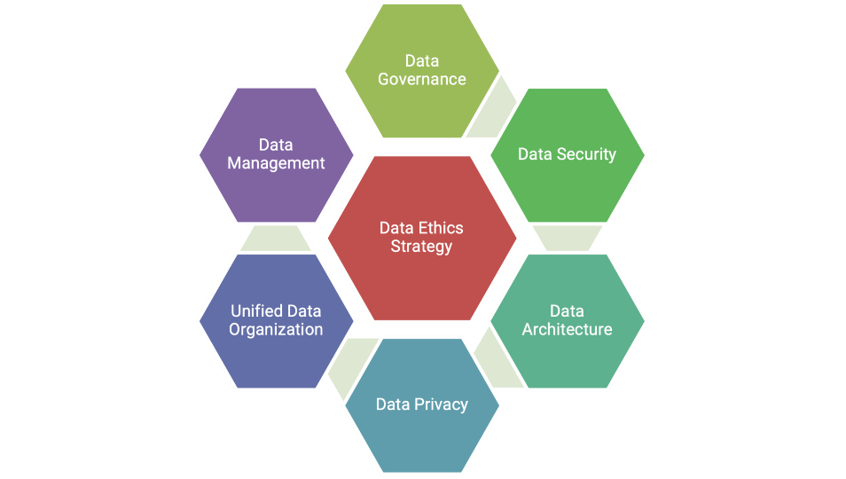
The Role of Ethics in Informing Data-Driven Decisions
Data ethics refers to the moral principles and values that guide the design, development, and use of data-driven systems, ensuring that they are fair, transparent, and respectful of individuals and society.
Ensures fairness and non-discrimination in data-driven decisions
Protects individual privacy and autonomy
Encourages transparency and accountability in data analysis and decision-making

Slide 38
Importance of Considering Ethical Implications of Data-Driven Decisions
Data-driven decisions can have significant social and economic impacts
Ethical considerations can mitigate potential harms and biases
Ignoring ethical implications can lead to mistrust and reputational damage

Slide 39
Strategies for Integrating Ethics into Data-Driven Decision-Making
Establish an ethics committee or review board
Conduct ethical impact assessments
Develop ethical guidelines and principles
Provide training and education on data ethics

Slide 40
Ethical Considerations in Data Analysis and Interpretation
Avoiding misleading or deceptive analysis
Ensuring transparency and reproducibility in data analysis
Considering alternative explanations and perspectives
Avoiding bias and discrimination in data interpretation

Slide 41
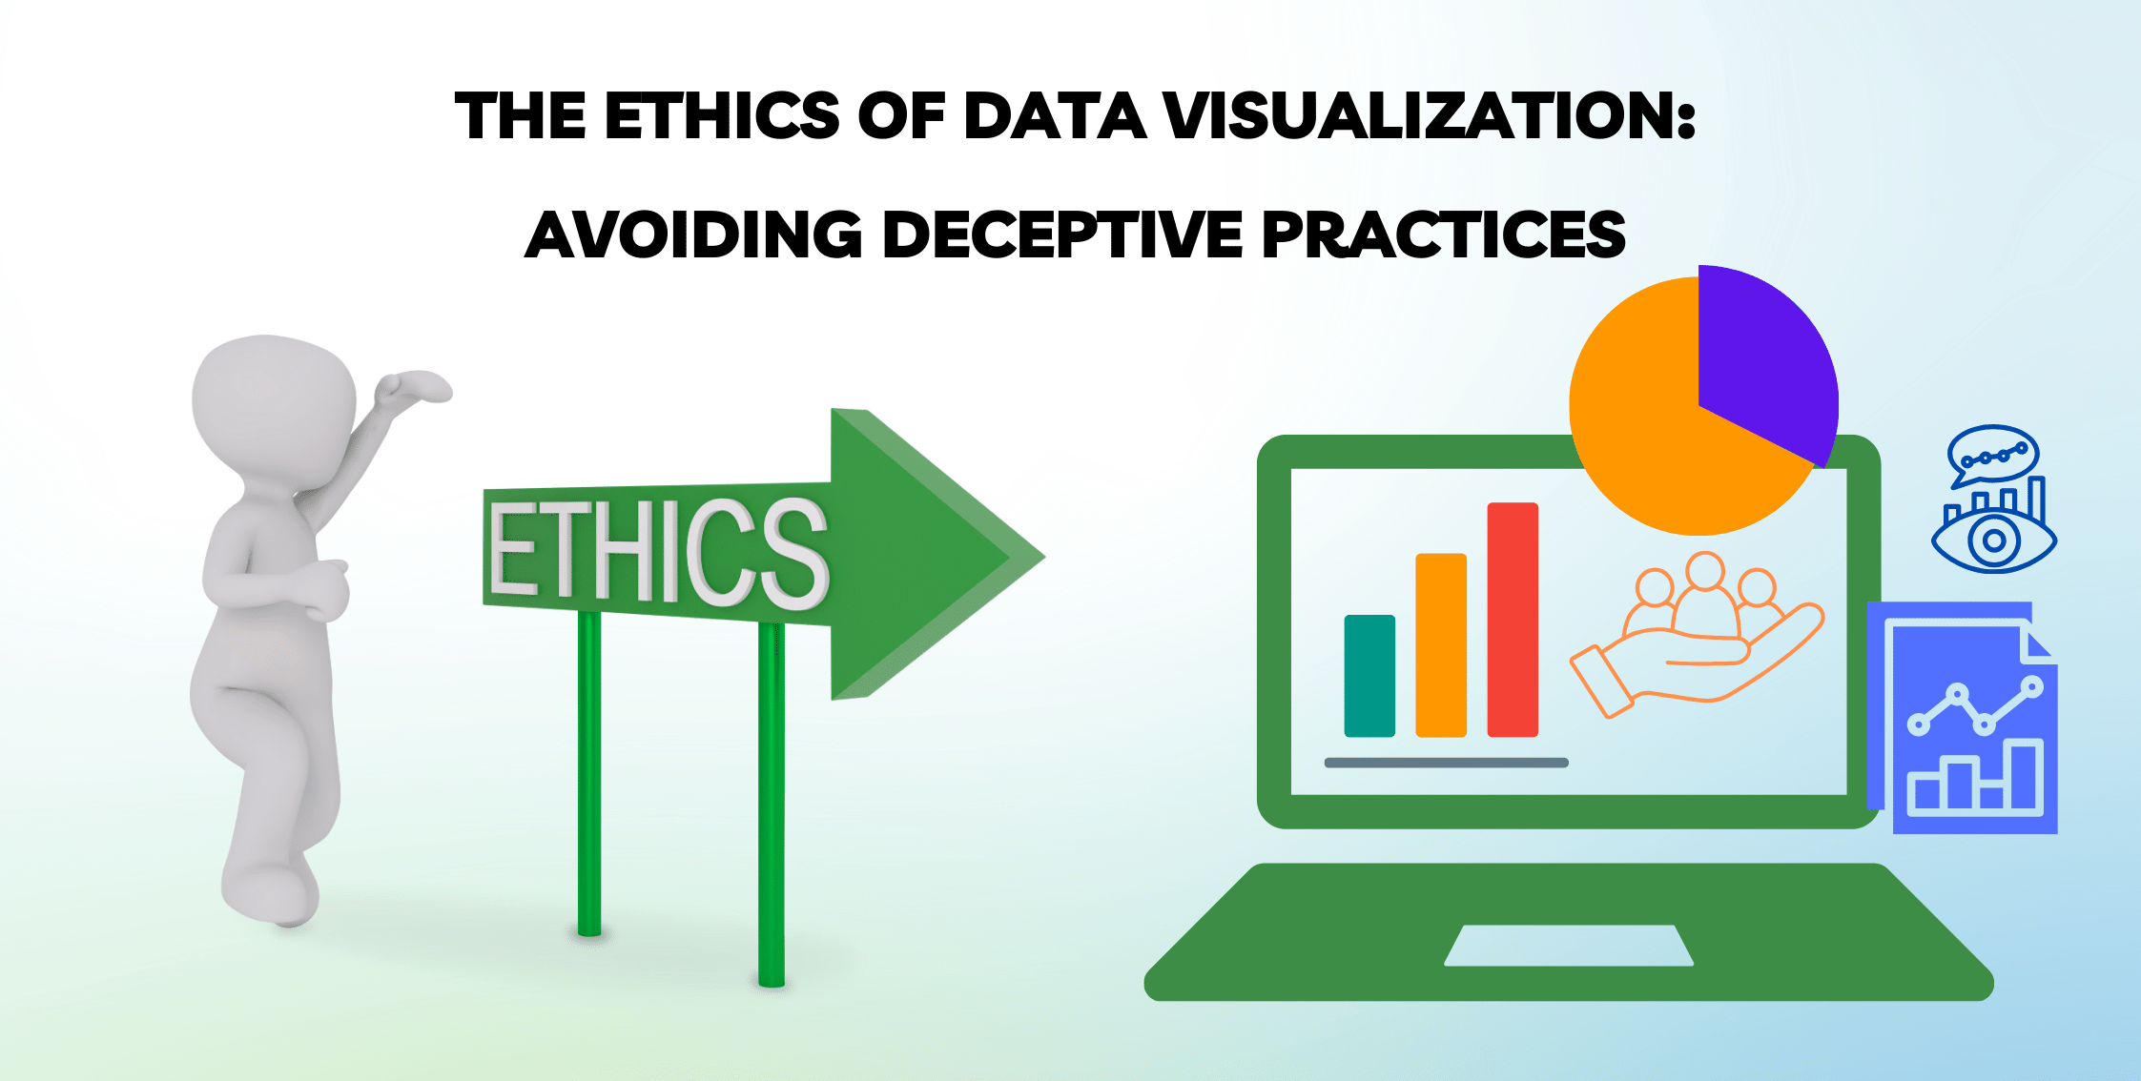
Avoiding Misleading or Deceptive Analysis
Using clear and transparent methods and assumptions
Avoiding cherry-picking or selective reporting of data
Providing context and caveats for data analysis
Disclosing potential conflicts of interest

Slide 42
Ensuring Transparency and Reproducibility in Data Analysis
Documenting data sources and methods
Providing access to data and code
Using open-source and transparent tools and methods
Encouraging peer review and replication

Slide 43
Ethical Considerations in Data Visualization
Avoiding misleading or deceptive visualizations
Ensuring transparency and clarity in data visualization
Considering alternative visualizations and perspectives
Avoiding bias and discrimination in data visualization

Slide 44
Cambridge Analytica (CA)
Political Consulting and Data Analytics
Background: Cambridge Analytica was a UK-based political consulting firm that used data analytics to influence electoral outcomes. In 2014, CA worked with the Ted Cruz presidential campaign in the US, and later with the Donald Trump presidential campaign in 2016.
Ethical Considerations:
Data Privacy: CA harvested personal data from millions of Facebook users without their consent, using a third-party app that collected data from users and their friends. This violated Facebook's terms of service and compromised the privacy of millions of users.
Data Manipulation: CA used the harvested data to create psychological profiles of voters, which were then used to target them with personalized political ads. This raised concerns about the manipulation of voters and the potential to influence electoral outcomes unfairly.
Lack of Transparency: CA's data collection and analysis methods were opaque, making it difficult for users to understand how their data was being used. This lack of transparency raised concerns about accountability and the potential for misuse.
Bias and Discrimination: CA's algorithms and models were criticized for perpetuating biases and discrimination, particularly against minority groups. This raised concerns about the potential for data-driven decision-making to exacerbate existing social inequalities.

Slide 45
Cambridge Analytica (CA)
Consequences:
Facebook Data Breach: The scandal led to a massive data breach, with millions of users' data compromised.
Legal Consequences: CA faced legal action from regulators and individuals, including a lawsuit from the New York Attorney General.
Reputation Damage: The scandal damaged CA's reputation, leading to the closure of the company in 2018.
Regulatory Reforms: The scandal prompted regulatory reforms, including the introduction of the General Data Protection Regulation (GDPR) in the EU and the California Consumer Privacy Act (CCPA) in the US.

Slide 46
Benefits of Integrating Ethics into Data-Driven Decision-Making
Enhances trust and reputation
Improves decision-making quality and accuracy
Reduces risk of ethical breaches and reputational damage
Encourages innovation and creativity

Slide 47
Best Practices for Integrating Ethics into Data-Driven Decision-Making
Establish a clear ethical framework and guidelines
Provide training and education on data ethics
Encourage transparency and accountability
Foster a culture of ethics and responsibility

Slide 48
Case Studies and Examples

Slide 49
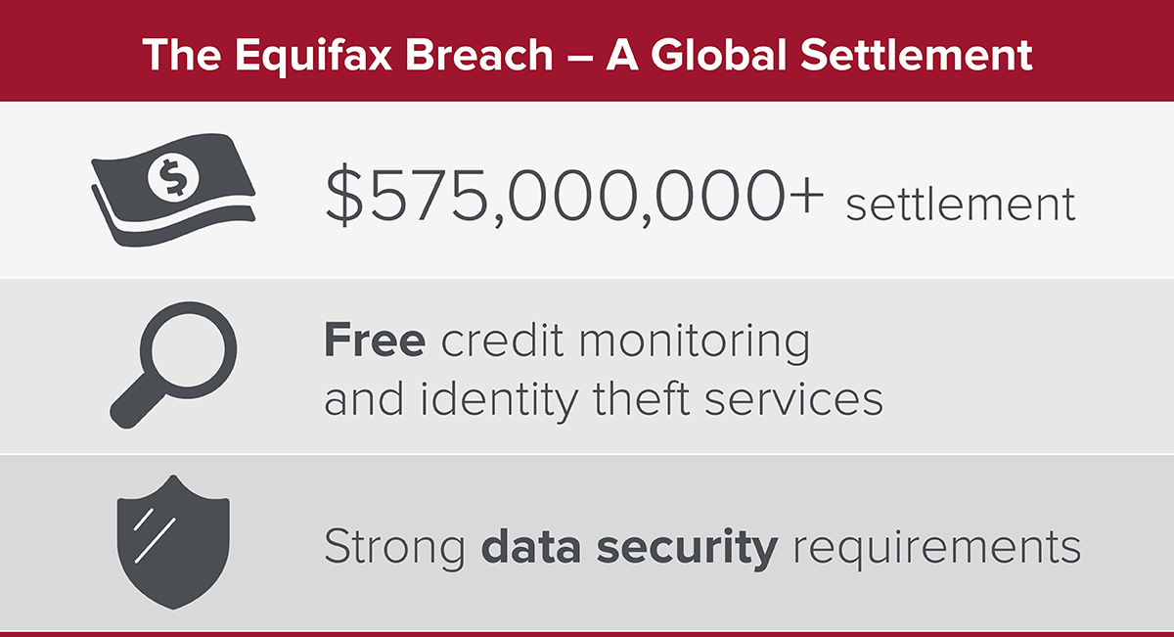
Case Study 1: Equifax Data Breach
A Data Breach of Epic Proportions
In 2017, Equifax, one of the largest credit reporting agencies in the world, suffered a massive data breach that exposed sensitive information of over 147 million people.

Slide 50
Consequences of the Equifax Data Breach
Exposure of sensitive information, including Social Security numbers, birth dates, and addresses
Identity theft and fraud
Financial losses for individuals and businesses
Damage to Equifax's reputation and stock price

Slide 51
Causes of the Equifax Data Breach
Failure to patch a known vulnerability in Apache Struts
Lack of encryption for sensitive data
Inadequate security measures and monitoring
Human error and negligence

Slide 52
Lessons Learned from the Equifax Data Breach
Importance of patching vulnerabilities and keeping software up-to-date
Need for encryption and secure storage of sensitive data
Importance of regular security audits and monitoring
Accountability and transparency in data management

Slide 53
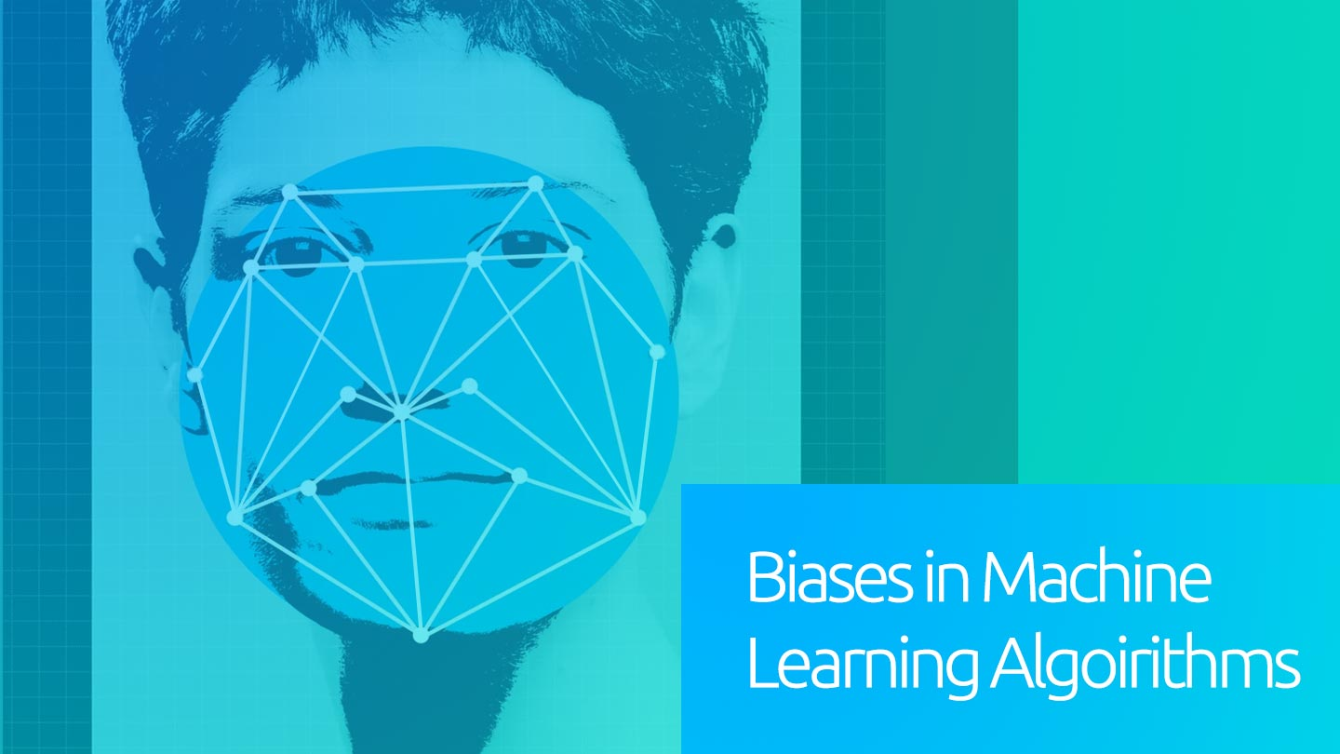
Case Study 2: Data-Driven Decision-Making - Amazon's AI-powered Hiring Tool
A Cautionary Tale of Bias in AI
In 2018, Amazon developed an AI-powered hiring tool to streamline its recruitment process. However, the tool was found to be biased against women, highlighting the importance of addressing bias in AI-powered decision-making tools.

Slide 54
What Happened
Amazon developed an AI-powered hiring tool to analyze resumes and identify top candidates
The tool was trained on resumes submitted to Amazon over a 10-year period, which reflected the company's existing gender imbalance
As a result, the tool learned to prefer male candidates, perpetuating gender bias in hiring

Slide 55
Consequences
Gender bias: The biased tool perpetuated gender bias in hiring, potentially excluding qualified female candidates
Lack of transparency: The proprietary nature of the algorithm made it difficult to identify and address the bias
Ethical dilemmas: The case raised ethical questions about the use of AI in hiring and the potential for bias

Slide 56
Lessons Learned
Importance of addressing bias in AI-powered decision-making tools, particularly in high-stakes applications like hiring
Need for transparency, accountability, and regular auditing to ensure fairness and equity
Importance of diverse and representative training data to prevent bias
Need for human oversight and review to detect and correct bias

